Slide 1
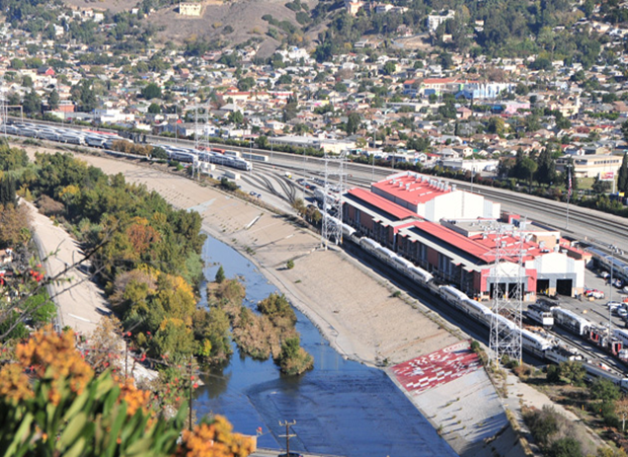
CMF Community Meeting
30-Day Follow-Up
May 9, 2019

Slide 2
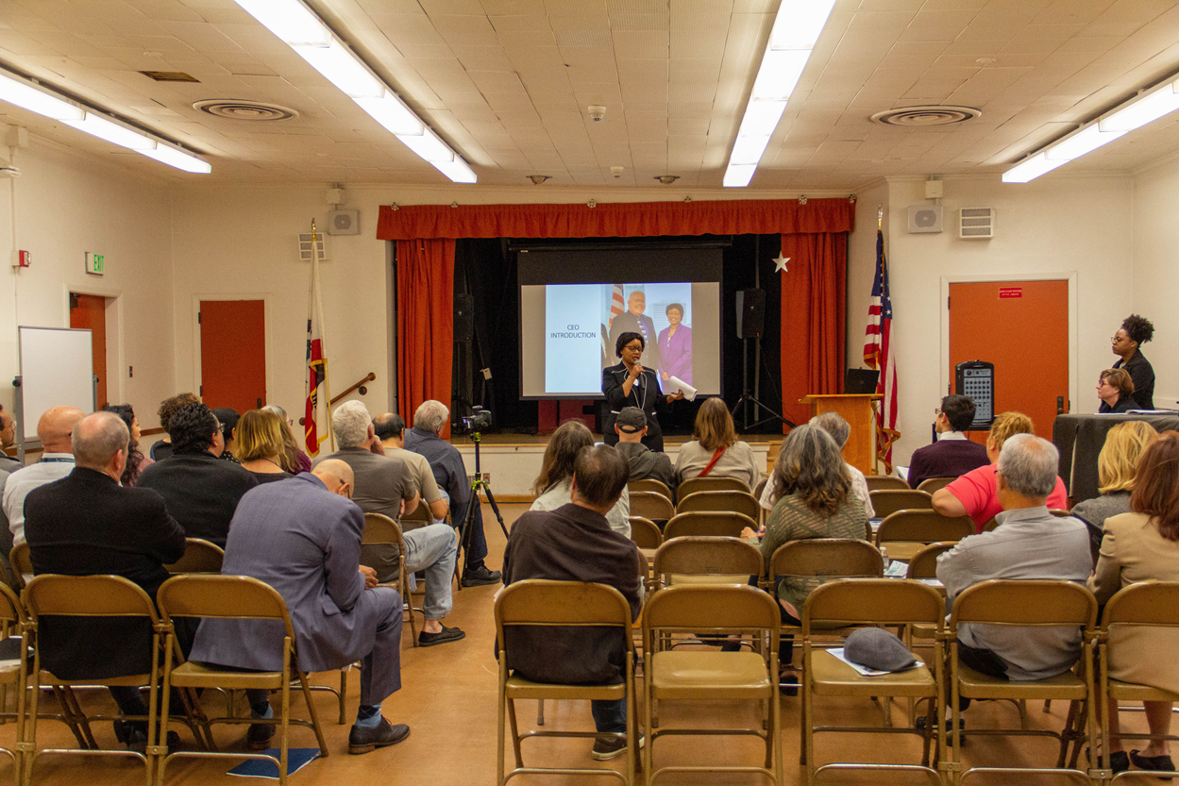
Notes:
Mary McCormick- welcome audience and describe slightly different meeting format. Introduce Sylvia.
Sylvia Novoa (Bilingual Introduction, Spanish translation services)
Mary will introduce Laurene Lopez who will describe “question card” process.

Slide 3
AGENDA
30-Day Commitment by Metrolink CEO
Focused Community Action Plan
Our Future with You
Notes:
Laurene – Welcome and thank you for attending this follow-up meeting from our April 11th meeting.
We will be covering 3 areas in our meeting this evening
Our 30-day commitment from our CEO
Our focused community action plan and
Our future with the communities we serve
I would now like to introduce our CEO Stephanie Wiggins

Slide 4
30-Day Commitment
My commitment:
Listen and review the requests with fresh eyes
Return to the community within 30 days with an Action Plan
Notes:
Stephanie Wiggins, CEO – “My commitment to you – return in 30 days”
I appreciate the time many of you spent at the last meeting. I realize this is a very emotionally charged issue because it impacts your quality of life, health and safety. After meeting with my team and reviewing the concerns you expressed, I believe there is validity to many of your concerns and requests. I want to be a good neighbor and make the additional enhancements to our yard and operations so that we can help to improve your quality of life. ​
​
My team has developed an Action Plan with steps we can take starting this month and continue into the future.

Slide 5
What We Heard
Accountability & Oversight concerns
Noise/Emission Impacts due to Locomotive Testing and Servicing
Hood Technology information request
AQMD Idling Rules: 3501 & 3502 and City of LA Noise Ordinances
Notes:
Stephanie Wiggins, CEO
We heard 8 points from the last meeting:
Accountability & Oversight concerns
Noise/Emission Impacts due to Locomotive Testing and Servicing
Hood Technology information request
Adherence to AQMD Idling Rules: 3501 & 3502 and City of LA Noise Ordinances

Slide 6
What we heard
Relocation of CMF
Reduce or eliminate weekend work
Overall work hours​ reduction request
Comment Tracking
Notes:
Stephanie Wiggins, CEO
Relocation of CMF
Reduce or eliminate weekend work
Overall work hours​ reduction request
Comment Tracking
If asked: “Yes we do have an internal system to track comments we receive from the public.”

Slide 7
Since Our Last Meeting
Internal meetings with the Depts of Operations, Engineering, and, Public Affairs to discuss community's concerns
Additional meetings with Metro regarding third-party noise study
Scheduled meeting with Hood Emission Control Technology company – First week of June
Developed overall Action Plan
Notes:
Stephanie Wiggins, CEO
As we were developing the Action Plan, we wanted to look at how we can take some immediate actions to be as friendly as we can to our neighbors.

Slide 8
2016 24/7 hotline:
(213) 452-0400 created
2016 Tier 4 arrives.
2016 Changed blowers on Tier 4 to minimize sound.
2010 Automatic Engine Start Stop (AESS) technology reduces noise/emissions from idling
2010 to 2018 Fuel Conservation Program reduced emissions by 79%
2014 Health Risk Assessments (HRA)
2018 Community follow up on Sound Study
2016 opening of EMF reduced the number of trains at CMF by 20%
2017 Tier 4 in service
2017 Sound Study
2012 Plug-in Program to reduce noise/emissions from idling
2012 “Reduced Use of Bells” policy decreased bell noise by 70-80%
Results
Reduced number of trains serviced from 32 to 25 in 2016
Agreed not to load test at the CMF on the weekends before 10 a.m.
Operational changes in 2010 reduced noise by 40%
Notes:
Stephanie Wiggins, CEO
I will go into detail regarding the improvements that have occurred at the CMF as a result of community involvement.

Slide 9
Focused Community Action Plan
Audit Current Operations
Conduct New Noise Study
CMF Facility Modernization
Notes:
Speakers: Stephanie Wiggins, CEO
As you have seen in the previous slide, we have been working hard for several years to improve our operations. However, we are now at a new juncture.
We want to review how we are currently operating.
We want to continue with our noise studies, working closely with other agencies to follow current guidelines
Most importantly, we must look to the future and how to address the expansion requests from our riders. The communities we serve are a key and integral part to this program. We are very interested in creating a collaborative communication environment, that will help us build the best possible facility and you, our partners in this effort.
So, having said that, we need to upgrade our aging, 30 year-old maintenance facility to implement cutting-edge air quality techniques and noise reduction technologies.
We can’t do that in a vacuum.

Slide 10
Action Plan Timeline
Short Term 0 – 6 months
Medium Term 6 – 18 months
Long Term More than 18 months
Notes:
Speakers: Stephanie Wiggins, CEO
-defines timeline of Action Plan
-Stephanie Wiggins introduces Darrell

Slide 11
Action Plan: Short Term (0-6 months)
Current Operations:
1. Optimize use of ground power stations to reduce idling
2. New installation of sound monitors
3. Performance Audit Report- initiated
Notes:
Speakers: Darrell Maxey – Interim Chief Operating Officer, Carlos Perez – Assistant Director, Maintenance of Equipment
We want to be a good neighbor and work with you to reduce the impacts of CMF, especially those related to noise and emissions. With this goal in mind, I have instructed my staff to explore the possibilities of additional yard work adjustments and facility enhancements to address these issues. These changes will can be categorized into short, mid and long term.
The community has a very important voice in the design of the renovated facility.
This is a key moment in time, to work with the community.
We are on the verge of creating our future and we want to integrate the your voice into that future.
Darrell and Carlos, Please be specific in your timeline on each slide. (i.e 30 days, 90 days)

Slide 12
Action Plan: Short Term (0-6 months)
4. Noise Monitoring
LA METRO New Noise Study
Explore and implement mitigations
5. Expediting Tier 4 Locomotives into Service
Currently 23 Tier 4 locomotives on SCRRA property (15 are in service/8 remain being prepared for service)
Deploy the remaining 8 Tier 4 locomotives
Notes:
Speakers: Darrell Maxey – Interim Chief Operating Officer, Carlos Perez – Assistant Director, Maintenance of Equipment
Darrell to speak to point: LA METRO Sound Study will include AQMD Idling Rules 3501 & 3502 and City Noise Ordinances.

Slide 13
Action Plan: Medium Term (6-18 months)
6. Fleet Modernization Study will include:
Identification of other emission control methods
Review of battery-operated locomotives
7. CMF Modernization Study will include:
Review of 30+ year old facility
Identify state-of-the-art facility operations
Integrate community input into service expansion design
Notes:
Speakers: Darrell Maxey – Interim Chief Operating Officer, Carlos Perez – Assistant Director, Maintenance of Equipment
There are 2 major studies that will be implementing
A Fleet Modernization Study and
A CMF Modernization Study
They will include: (review bullet points)

Slide 14
Action Plan: Medium Term (6-18 months)
8. Work towards Zero-Emission Facility
Identify other emission control methods
9. Anticipate all 40 Tier 4 locomotives in service by Summer of 2020
Notes:
Darrell Maxey, Interim Chief, Operating Officer / Carlos Perez – Assistant Director, Maintenance of Equipment
Continuing with our Medium-Term goals we will:
Identify other emission control methods
Anticipate that all 40 of our Tier 4 locomotives (which is the cleanest standard for locomotives in the U.S) to be in service by summer of 2020.

Slide 15
Action Plan: Long Term (+18 months)
10. Work towards a Zero-Emissions Future
Pilot program- Explore Battery operated locomotives (initially used in combination with diesel electric)
Notes:
Darrell Maxey, Interim Chief, Operating Officer / Carlos Perez – Assistant Director, Maintenance of Equipment
We also have a “Zero-Emissions Future”. We are moving toward eliminating emissions with new technology and we are exploring the technology of battery-operated locomotives.
We will continue to pursue opportunities to eliminate emissions.

Slide 16
How to Reach Us
www.metrolinktrains.com/community
communityrelations@scrra.net
Public Affairs Hotline (213) 452-0400
Monthly CMF updates via email
Next Community Meeting, Sept 2019
Notes:
Laurene Lopez- Public Affairs Manager
“Thank you Darrell, yes we want to look to the future and as we look to the future here is how we stay in touch.”
You can connect with us on the Internet, by email and by phone. We will also be providing updates on the CMF for those who are interested via email. We are committing to continuing our community meetings and the next one will be in September.
(Keep this slide up during Q&A)
Now I would like to turn the Panel Discussion portion of our meeting over to our facilitator, Mary McCormick

Slide 17
We would like to thank all customers, associates and partners for their support in enabling Metrolink to serve the community. In addition, we are hugely grateful to all participants for their time, insight and willingness to challenge views.

